Slide 1
Unit 202: Principles of electrical science
Principles of electricity

Slide 2
Electron theory
Structure of matter
The smallest part of any material is called a molecule and is made up of one or more atoms.
Basically, the atom is constructed of a central core containing protons surrounded by orbiting electrons.
PROTONS are POSITIVELY CHARGED
ELECTRONS are NEGATIVELY CHARGED
In an electrically neutral atom the number of PROTONS is equal to the number of ELECTRONS.

Slide 3
Electron theory
The simplest atom is hydrogen (1 proton and 1 electron).
The heaviest atom is uranium (92 protons balanced by 92 electrons).
The Helium atom has two protons and two electrons.

Slide 4
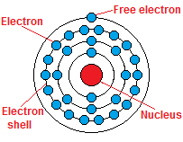
Electron theory
Copper atom – 29 protons and 29 electrons
An electrically neutral atom has as many (+ve positive) protons as there are (‑ve negative) electrons.
The single electron in the outer orbit of the copper atom is only loosely attached to the atom.

Slide 5

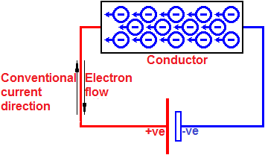
Electron theory
Electric current – random free electron movement
If the material is connected across a battery, the positive plate (or terminal) attracts electrons, whilst the negative plate repels them.
The battery provides a source of electromotive force (EMF).
The resultant electron flow around the circuit is called an electric current.

Slide 6
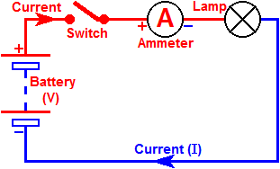
Electron theory

Slide 7
Electron theory
Conductors
silver gold copper aluminium mercury steel | sea water concrete mercury platinum brass | iron bronze graphite dirty water lemon juice
Insulators
rubber glass pure water oil air | diamond dry wood dry cotton plastic asphalt | fiberglass dry paper porcelain ceramic quartz

Slide 8
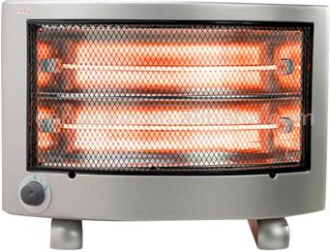
Electron theory
Effects of an electric current
Thermal

Slide 9
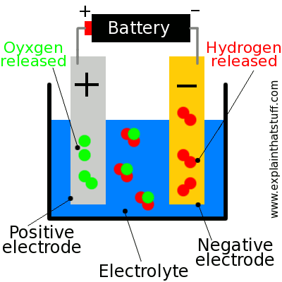
Electron theory
Effects of an electric current
Thermal
Chemical

Slide 10
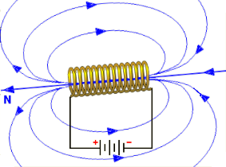
Electron theory
Effects of an electric current
Thermal
Chemical
Magnetic

Slide 11
Unit 202: Principles of electrical science
The End

